Slide 1
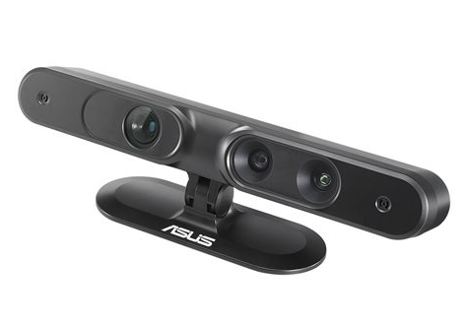
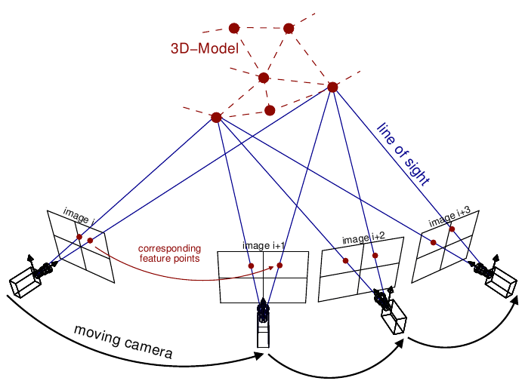
Picture courtesy: Van Riel, Sjoerd, “Exploring the use of 3D GIS as an analytical tool in archaeological excavation practice,” June 2016.
Structure from Motion and RGBD Depth Fusion
RGBD Sensor
Thesis Defense: Advised by : Committee:
Akash Chandrashekar Dr. Andrew Willis Dr. Srinivas Akella
Dr. Min Shin Dr. Hamed Tabkhi
SfM

Slide 2
Outline
What are depth maps and its applications
Economical source of depth measurement : RGBD sensor
Limitations of RGBD sensors
Efficient way to estimate depth : SfM
Limitations of SfM
Fusion of RGBD depth with SfM
Related and background study
Contribution and methodology
Results and further work

Slide 3
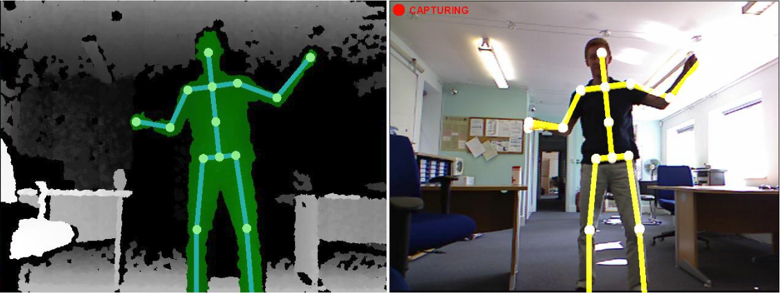
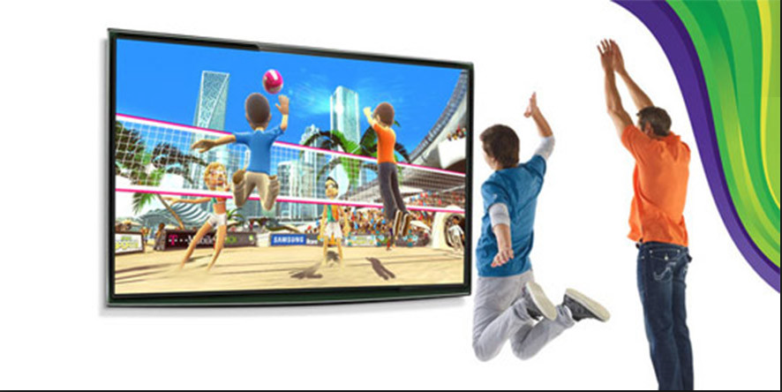
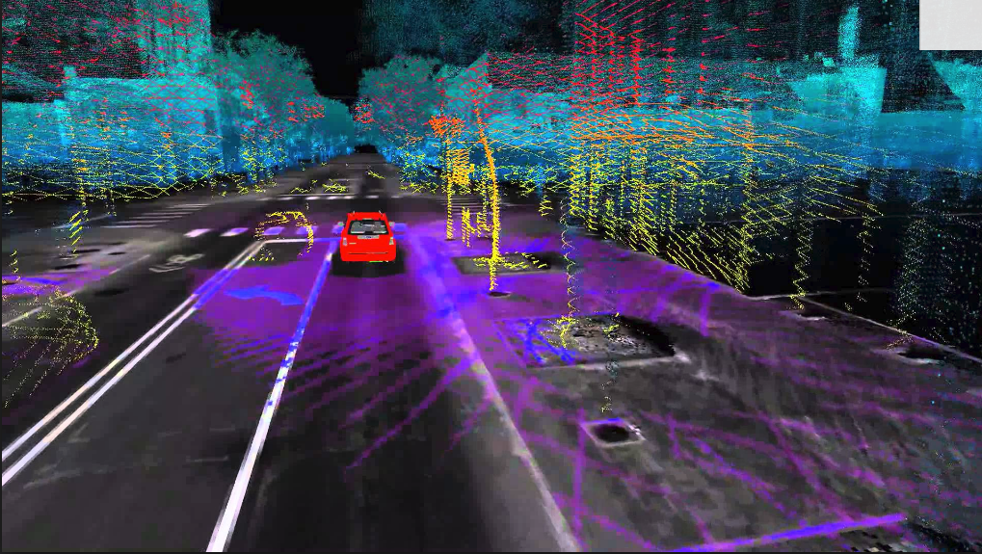
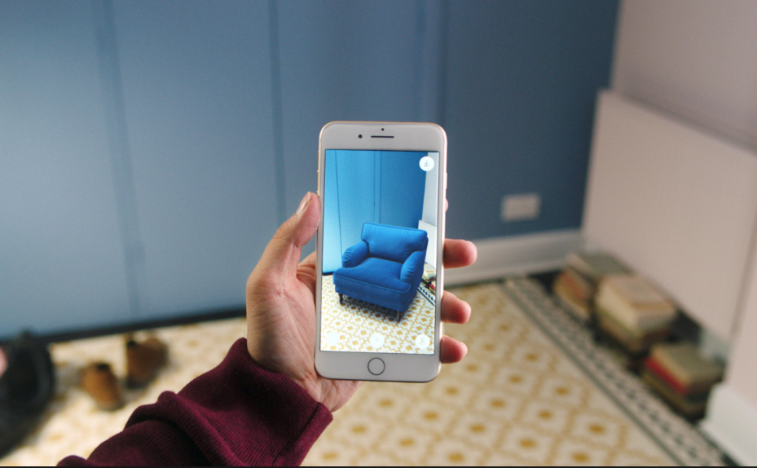
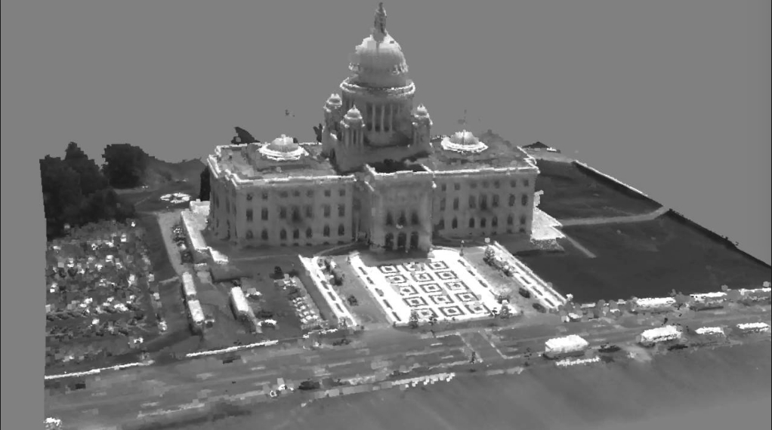
Depth maps and its Applications
Depth map is an image that contains information relating to the distance of the surfaces of scene objects from a viewpoint
Mapping and localization
Autonomous navigation/guidance
Augmented Reality
Interactive Gaming
Object Recognition
Motion capture
3D reconstruction
Picture courtesy: Google images

Slide 4
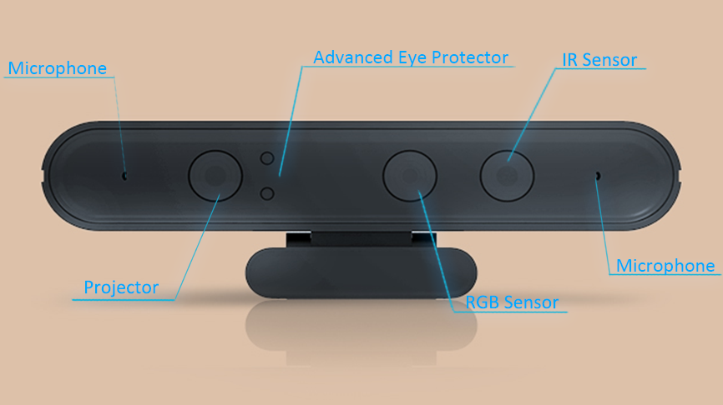
RGBD Sensors
Economical in comparison with LIDAR and SONAR. Make them suitable for consumer products.
Simultaneously capture color “RGB” images and the depth “D” images of the scene.
Relies on structured light technology to measure the depth of the scene.
Along with the traditional camera (RGB sensor) it has a infrared (IR) projector and a infrared (IR) sensor.
We have used Orbbec Astra Pro RGBD sensor.
Has a field of view of 60° horiz x 49.5° vert.
Captures RGB images of dimension 640 * 480 @ 30FPS.
Captures depth images of dimension 640 * 480 @ 30FPS.
Has range of 0.6 - 5 m.
Picture courtesy: Google images

Slide 5
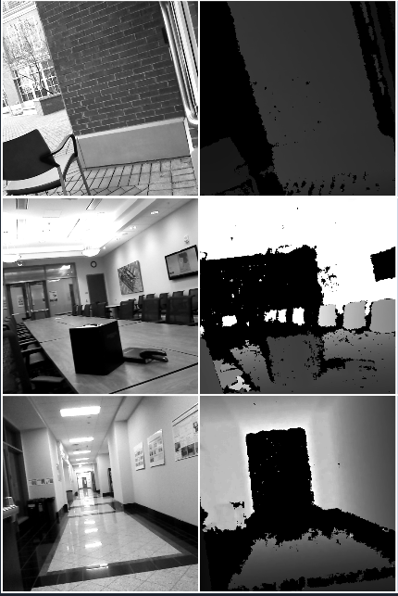
Limitations of RGBD Sensors
RGBD sensors often fail to provide meaningful depth values in sunlit outdoor scenes.
RGBD sensors also fails in sunlit indoor scenes.
RGBD sensors have range limitation (~5m).
RGBD sensors fail to collect measurements from from surfaces having specific reflectance properties like
Dark surfaces
Specular, mirror-like
Transparent surfaces

Slide 6
Structure From Motion (SfM)
The Structure from Motion (SfM) is a photogrammetric approach to estimate the three dimensional structure of a scene from a time series of RGB images.
The SfM consequently solves for two groups unknowns.
Relative pose of the camera between the frames , each poses are represented in Sim(3) with 7 degree of freedom.
Depth of 3D structure at all valid pixels , potentially there are w * h posible depths for each frame, where w and h are width and height of the frame .
Picture courtesy: Van Riel, Sjoerd, “Exploring the use of 3D GIS as an analytical tool in archaeological excavation practice,” June 2016.

Slide 7
Limitations of SFM
Scale of the estimated depth is always unknown.
If the errors are not handled, there will be a drift in the camera motion estimation and consequent depth estimation.
Computationally expensive.

Slide 8
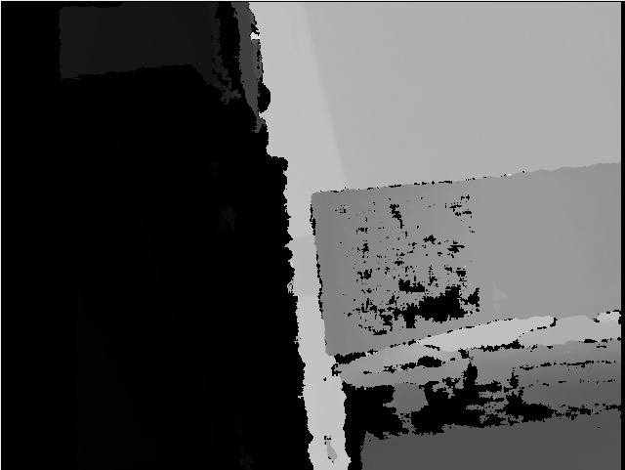
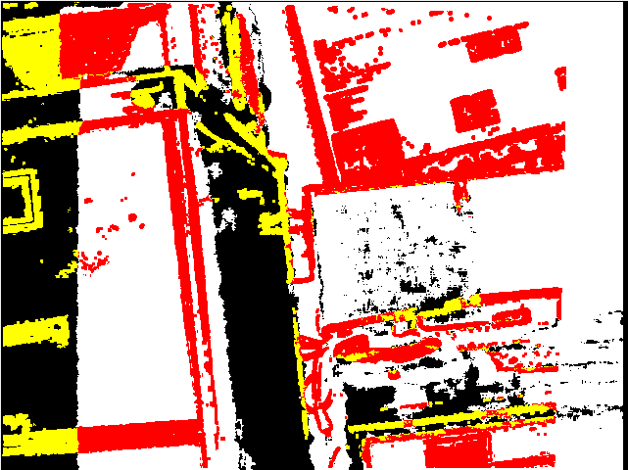
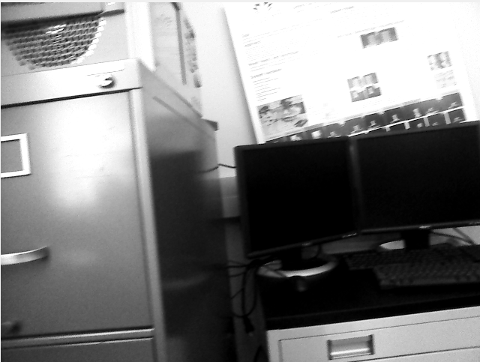
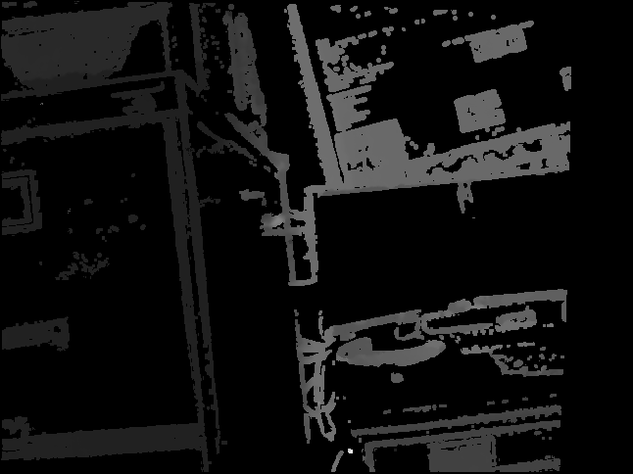
Fusion of RGBD depth with SfM
Bootstrap SfM with RGBD depths for scale injection.
Fuse missing RGBD measurements with SfM measurements.
RGBD measurements
Novel
SFM estimates
Fused depths

Slide 9
Large Scale Direct Monocular (LSD) SLAM
We are using LSD SLAM as our SfM implementation.
J. Engel, T. Schöps, and D. Cremers, “Lsd-slam: Large-scale direct monocular slam,” pp. 834–849, 2014.
The LSD-SLAM iteratively performs the below steps on every new frame:
Pose estimation
Depth estimation
Perform global optimization and loop closure

Slide 10
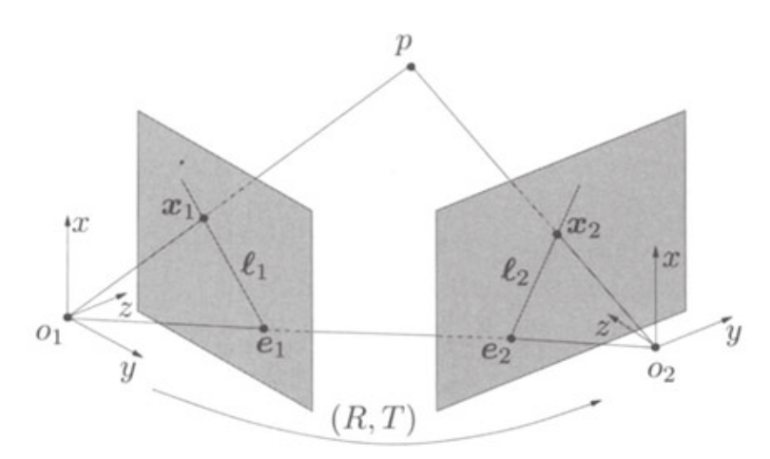
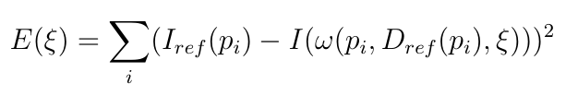
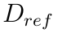
LSD SLAM 1: Pose Estimation
Pose is estimated by solving for image alignment.
The pose change between frames contains a rotation R and translation T, which are together represented by
They are estimated by optimizing the squared 2-norm of residuals called the reprojection error.
Where, I is the current keyframe and is the reference depth associated with it. is a subset of pixel with valid depths. is the projection function.

Slide 11
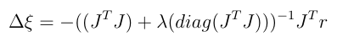
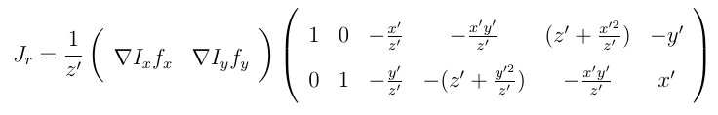
Non-linear optimization
Solving for optimal is a non-linear optimization problem.
Solved in iteration for linear change in by Levenberg_Marquardth algorithm.
r is the residual and J is its Jacboian.

Slide 12
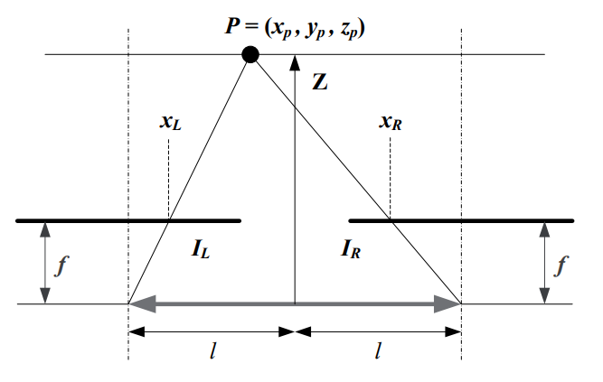
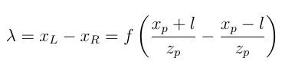
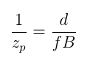
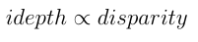
LSD SLAM 2: Depth Estimation
The LSD SLAM estimates depth, , by disparity, , mapping.
The amount of distance that the object have shifted from first image to second is called the disparity.
Picture courtesy: Google images

Slide 13
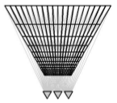
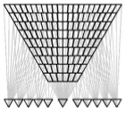
Multi-View Reconstruction
The problem with the fixed baseline disparity computation is that the error grows quadratically with depth.
The nearer depths have better accuracy but not the further depths
This can addressed efficiently by using adaptive baseline instead of fixed baseline
For given pixel, reference image is selected based on the age of the pixel.
Picture courtesy: D. Gallup, J. M. Frahm, P. Mordohai, and M. Pollefeys, “Variable baseline/resolution stereo,” in 2008 IEEE Conference on Computer Vision and Pattern Recognition, pp. 1–8, June 2008.

Slide 14
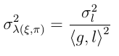
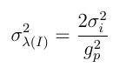
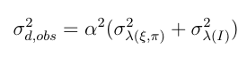
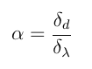
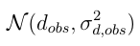
Semi-dense depth and its variance
Disparity is searched along the epiploar line , and influenced by the gradient of the image .
Defined by geometric disparity error and photometric disparity error

Slide 15
LSD-SLAM 3 : Graph Optimization
Efficient way to solve a complex nonlinear optimization problem
Takes advantage of sparse representation of the graph.
Easy definition of different spaces and supports arbitrary parameterizations within the same problem.
Keyframes are represented as nodes.
Relative pose between images are the constraint / edges between nodes.
Helps solve loop closure and global optimization.

Slide 16
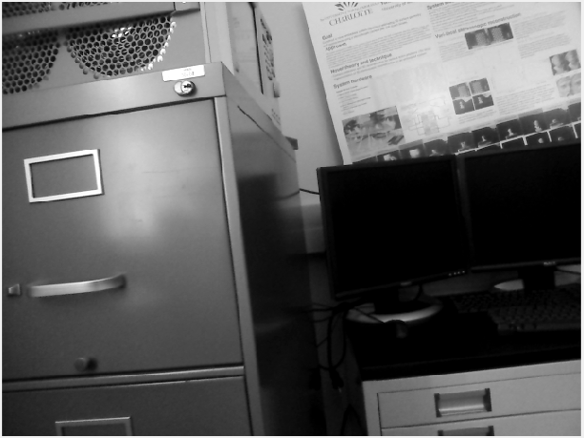
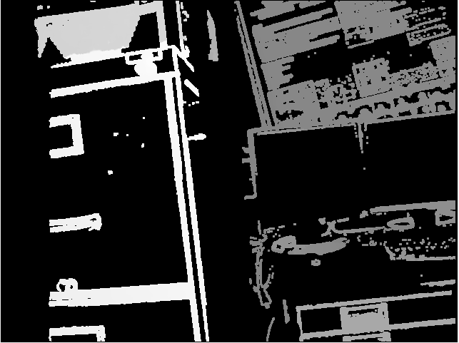
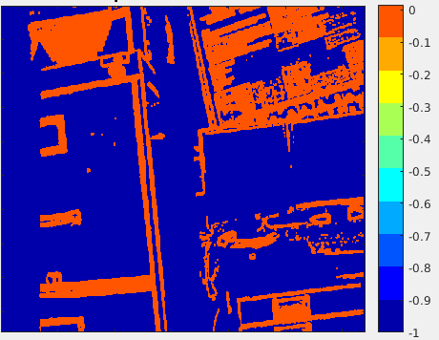
LSD SLAM Overview
Keyframe
LSD SLAM is a semi-dense, direct method.
It provides as an output, a reconstruction of the observed 3D environment as a pose-graph.
The pose is estimated between RGB frame and each RGB keyframe.
The depths are computed by estimating disparity along the epipolar lines between new tracking frame and reference frames.
For every keyframe a semi-dense depth map is generated along with its variance.
Keyframe depth
Depth variance

Slide 17
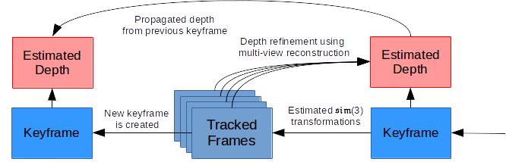
LSD SLAM pipeline

Slide 18
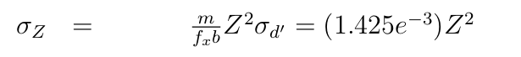
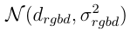
Noise Models
RGBD sensors provides depth measurements wherever it does not fail.
It is empirically observed that that a Gaussian noise model provides a good fit to observed measurement errors on planar targets, with mean zeros and sigma as below
With this variance, the sensor depth measurement at every pixel is represented as
We have the Gaussian noise model for LSD SLAM observed depths, which is represented as

Slide 19
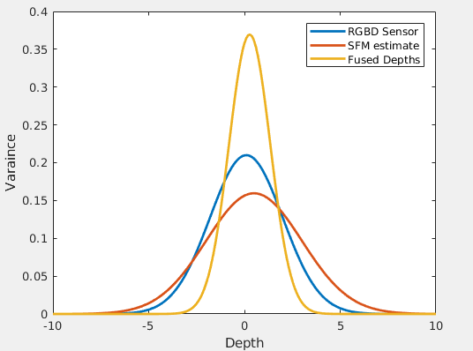
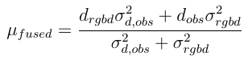
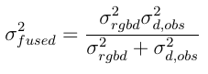
Depth Fusion
Depths are fused by Gaussian multiplication which provides better standard deviation.

Slide 20
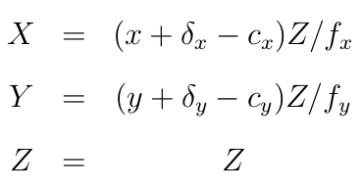
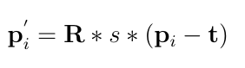
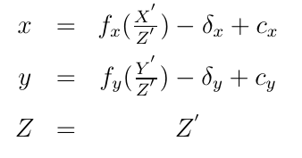
How to Compute Fused Depth at every frame
LSD SLAM generates depths only for keyframes.
However, LSD SLAM estimates the relative pose for every tracked frames.
Depth at very frames are extrapolated as following.
Depth from keyframes are back-projected into a point cloud.
The point cloud is transformed by the estimated relative pose.
Transformed point cloud is projected to the depth map at current tracked frame.

Slide 21
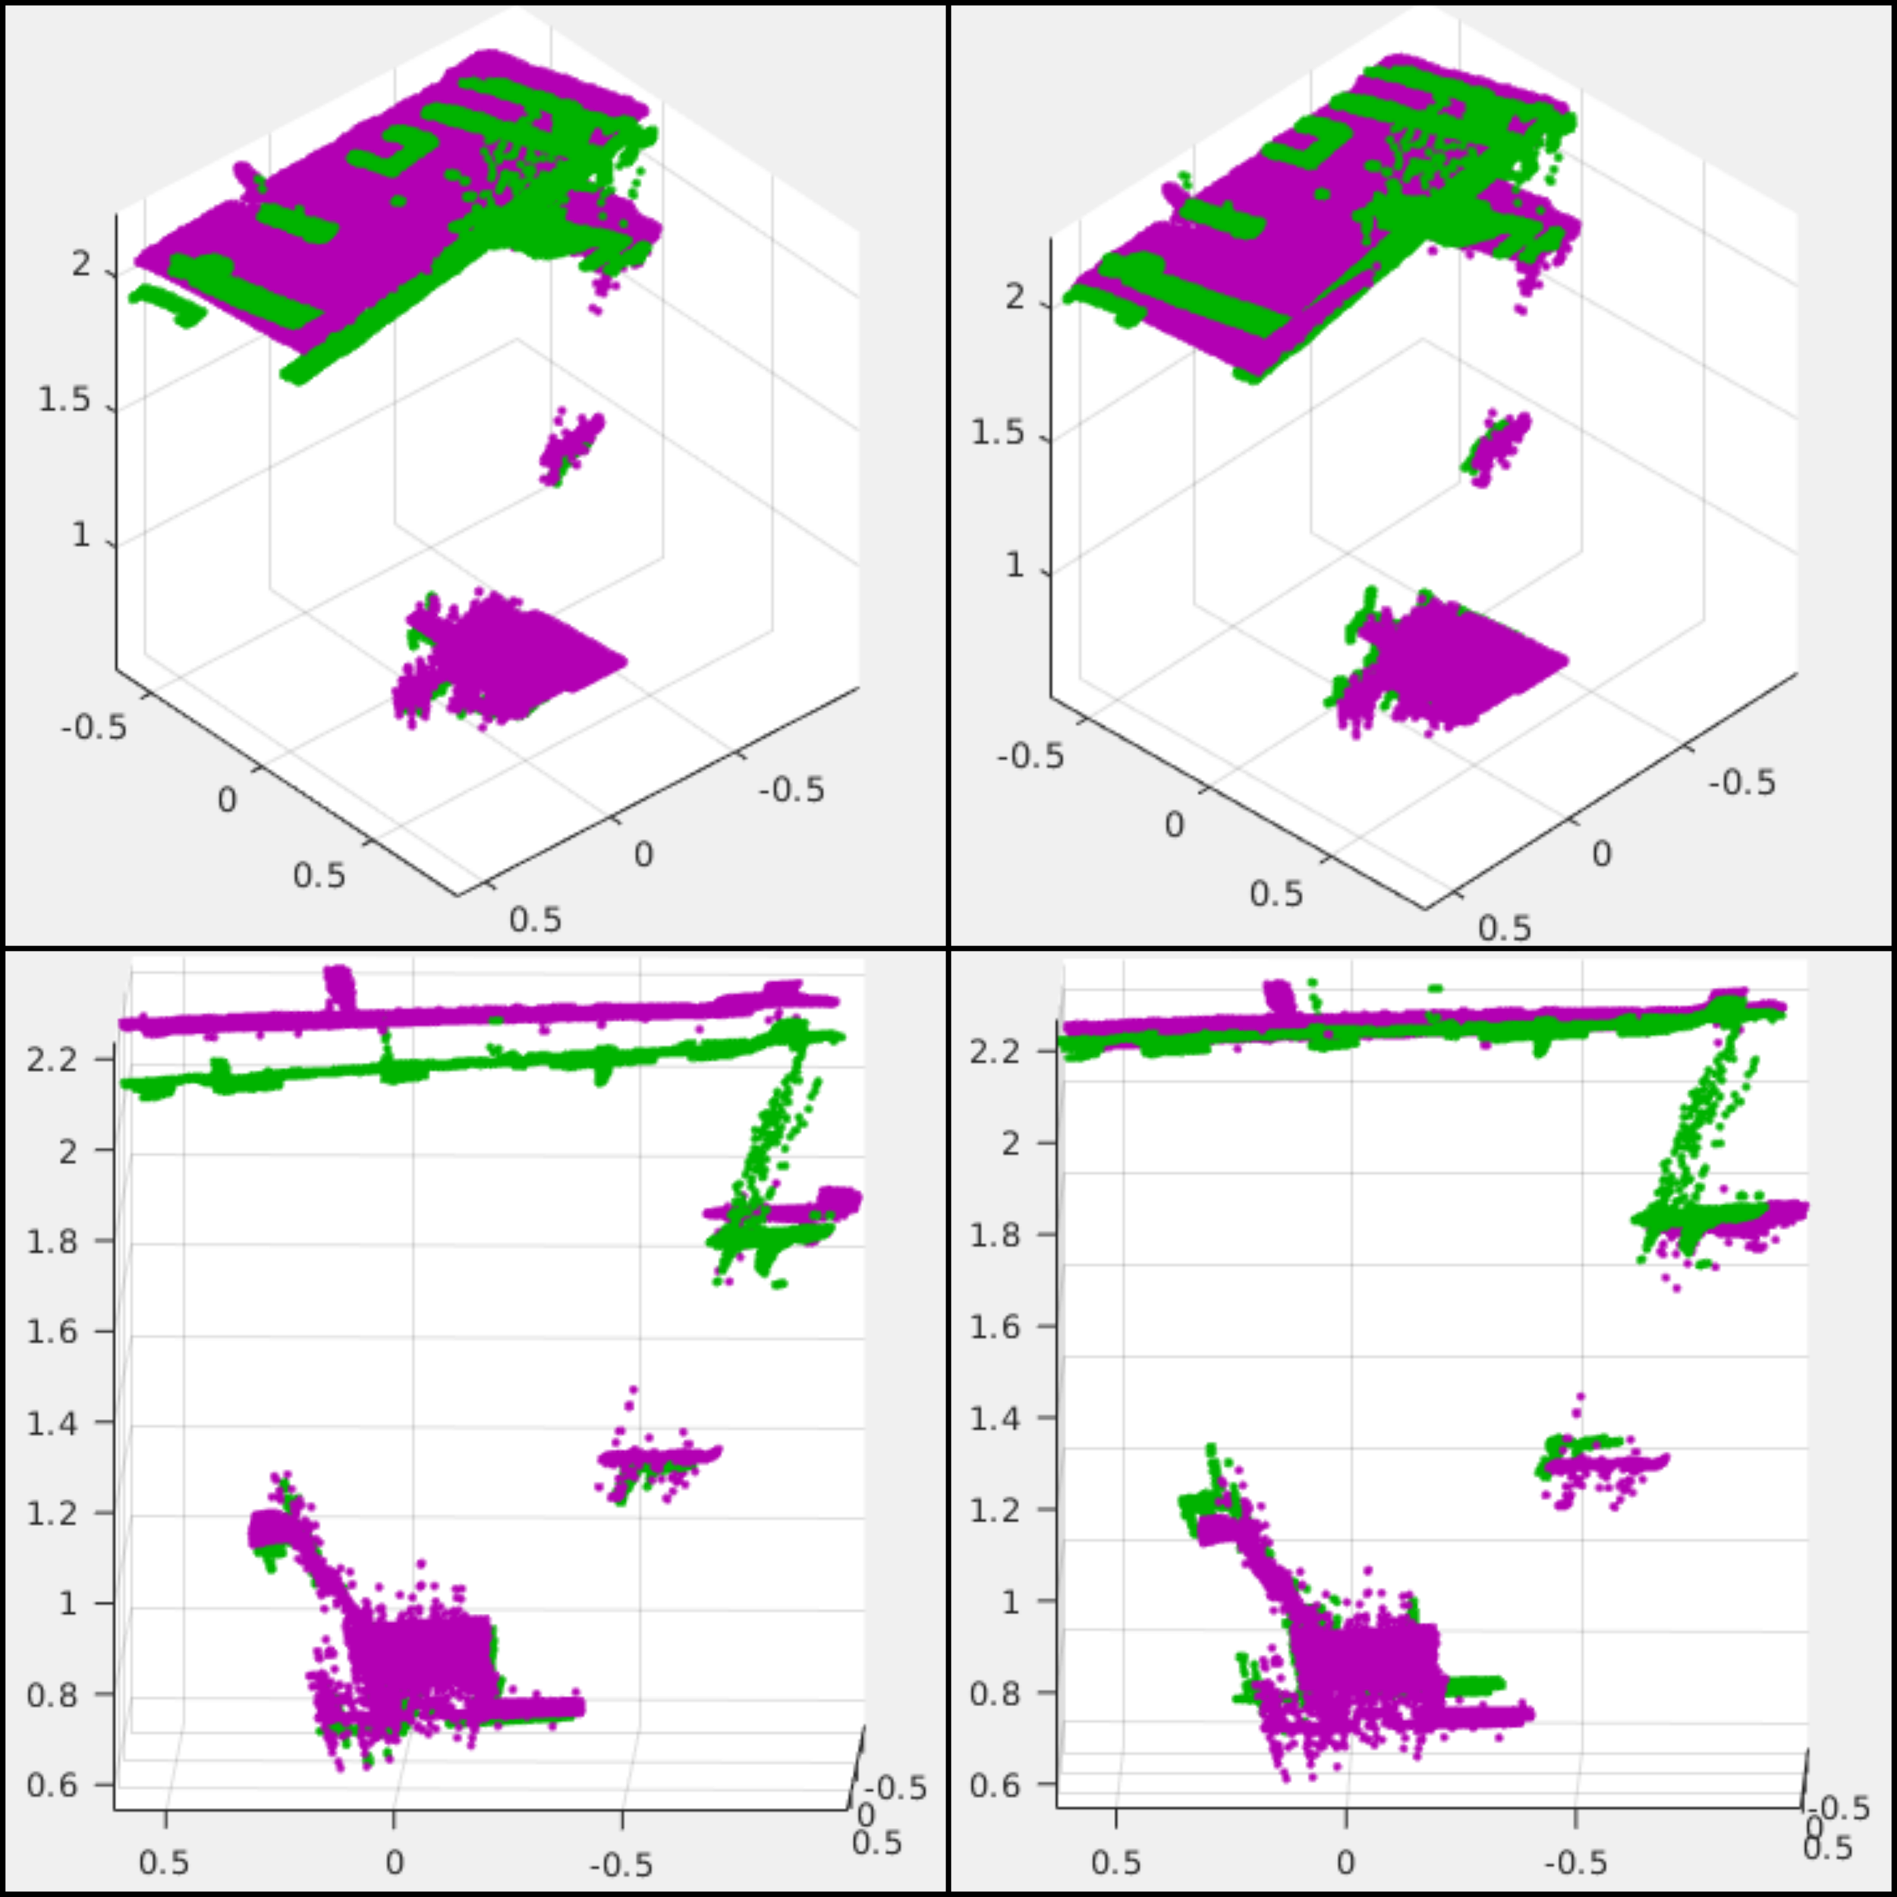
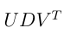
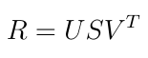
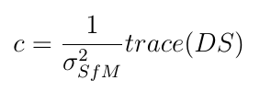
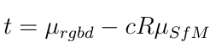
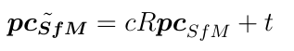
Point cloud registration
LSD-SLAM has inevitable errors because of noise.
The errors in scale and transformation needs to fixed
A SIM(3) ICP is applied to fix this error.
WIth SVD of covariance betewen points clouds as

Slide 22
Software Details
RGBD depth and intensity image were collected as a ROS bag @ 30 fps for ~ 30 seconds.
Intensity images were fed into C++ LSD-SLAM base implementation, which estimates depths from keyframes and relative pose between every tracked frame and keyframe.
Relative pose and keyframe depths are stored in a ROS bag.
Pose and depth estimates are fed into Matlab implementation of Depth fusion algorithm.

Slide 23
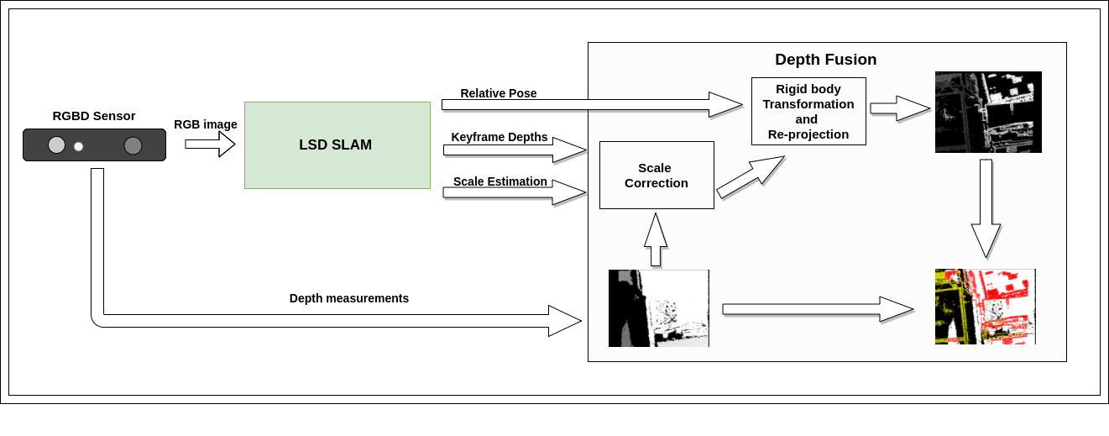
Depth Fusion pipeline

Slide 24
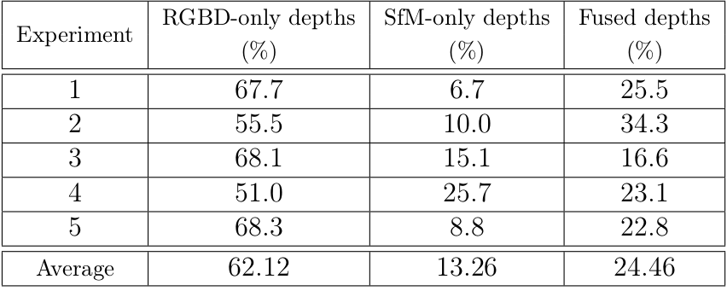
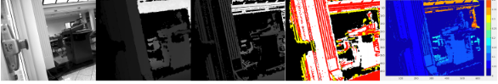


Results
Intensity | Sensor depth | LSD SLAM depth | Fused depth | Standard deviation

Slide 25

Results Continued
Intensity | Sensor depth | LSD SLAM depth | Fused depth | Standard deviation

Slide 26
Conclusion
The SfM depth estimation complements the RGBD sensor measurements.
The depth fusion algorithm provides the effective way to augment the RGBD depth stream.
Results in improved depth images, with approximately 24% of the fused depths and about 13% of novel depths from the SfM algorithm alone.

Slide 27
Further work
The depth fusion can be generalized to address the non-Gaussian noise distributions.
Back-propagation of RGBD-SfM fused depth imagery into the SfM algorithm can be exploited to improve the camera pose estimation in the camera pose graph.
Preprocessing of RGBD depth measurements to get rid of noisy speckles especially for outdoor measurements.

